Slide 1
Rotary Phase Converter Upgrade
Steven Vokoun
EEL4930 Final Project Presentation

Slide 2
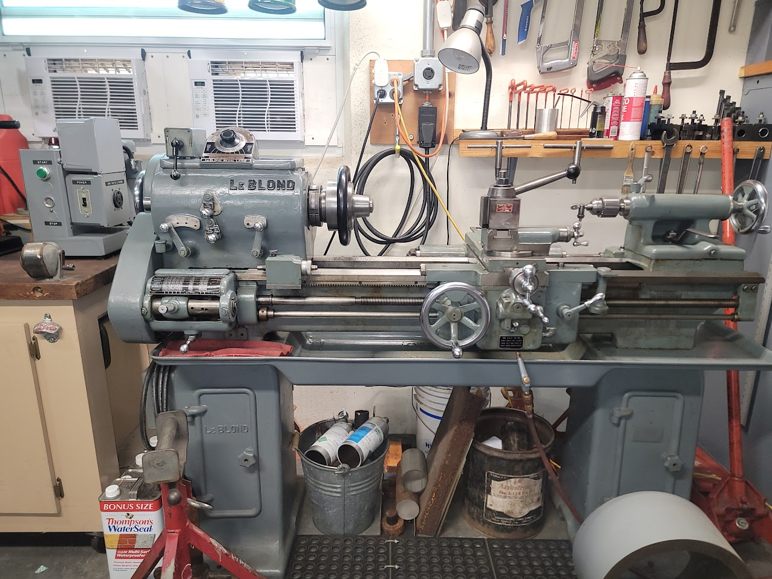
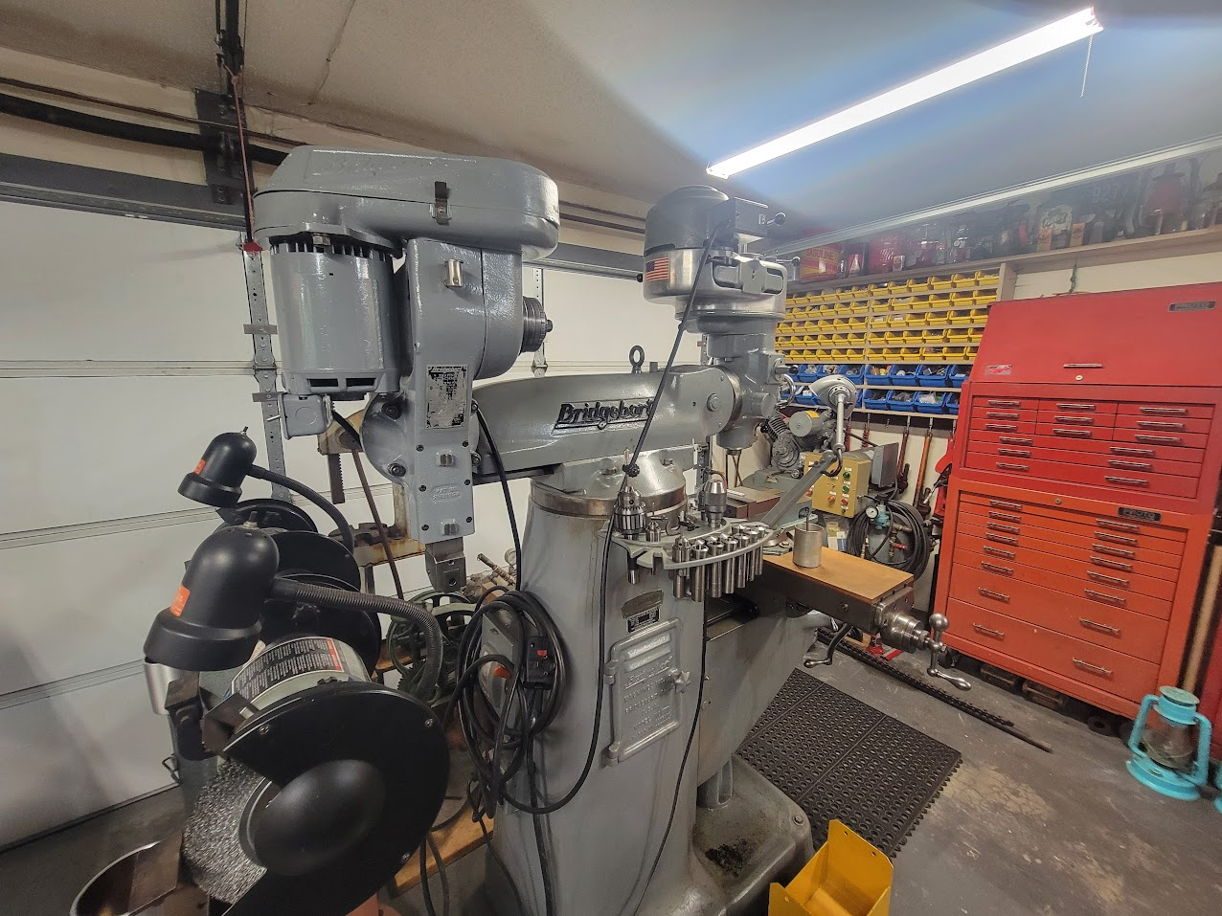
Motivation and Background
Hobby level machinists, woodworkers, and other specialties own three phase delta connected equipment
Cheaper second hand
More reliable
United States residential areas is typically singe-split phase power
Two 120V lines separated by 180 degrees

Slide 3

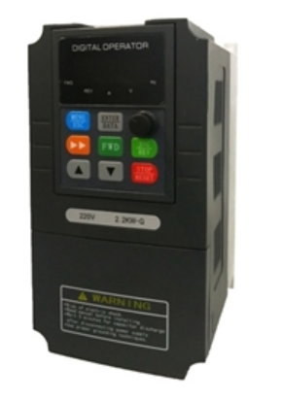
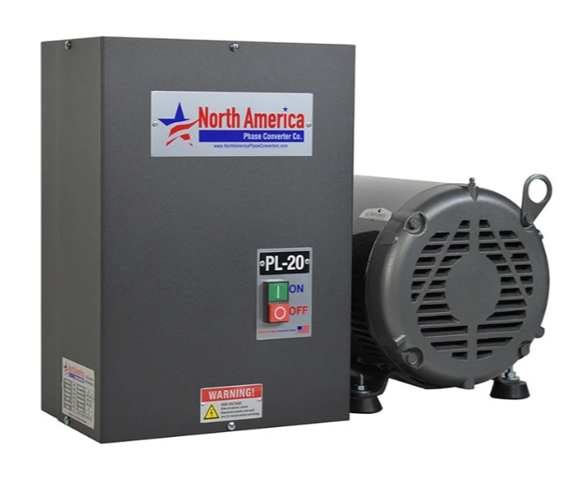
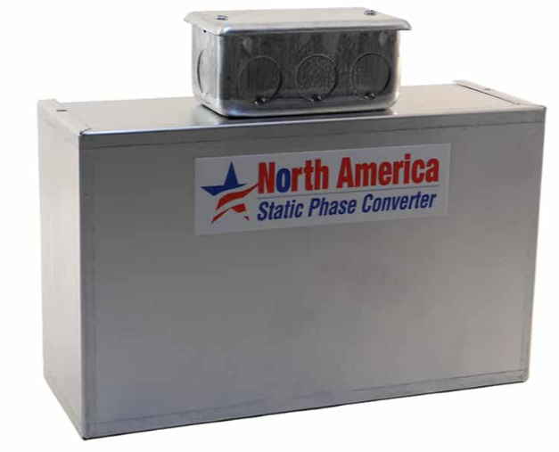
Choices For Single -> 3 Phase Conversion
VFD
Static
Rotary
Medium cost (200$)
Needs a separate VFD for every motor in a shop (custom configured settings per motor)
Gives advanced start, stop, and speed control
Can not run CNC or electronics
Cheap ($100)
1/3 Drop in Maximum HP on the tool
Need a different converter for every motor HP (capacitors have to be resized)
For purely motor loads only (no CNC etc.)
Expensive ($500-1000)
Runs full tool HP
Can feed into a three-phase power panel to run a whole shop
Can run CNC and electronics
Draws Idle Power, has to be manually enabled, and is noisy
Focusing On Rotary!
gohz.com
northamericaphaseconverters.com
northamericaphaseconverters.com

Slide 4
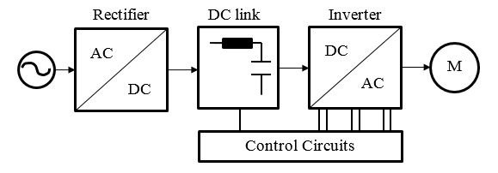
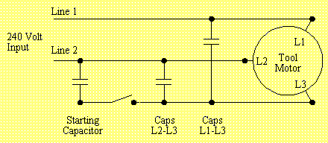
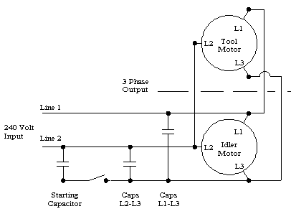
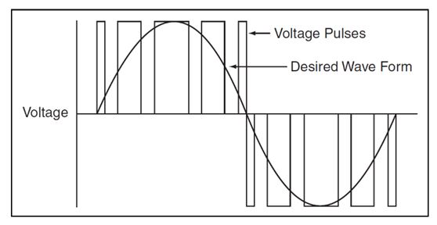
Choices For Phase Conversion
VFD
Static
Rotary
J. Ali Et. Al., “Design and Implementation of a Musical Water Fountain Based on Sound Harmonics Using IIR Filters,” IJCDS, vol. 9, no. 2, pp. 319–333, Jan. 2020, doi: 10.12785/ijcds/090217.
Waterfront Woods
Approximates three-phase using PWM signals
Known as “Single Phasing” a three-phase motor
Once you get is started via a starting capacitor or mechanical motion, can run on single phase itself
Waterfront Woods
Adds an additional motor in the mix
Single phases a “Idler Motor”, which in turn can power the Tool Motor off its generated third leg
vfd-softstarter.com

Slide 5
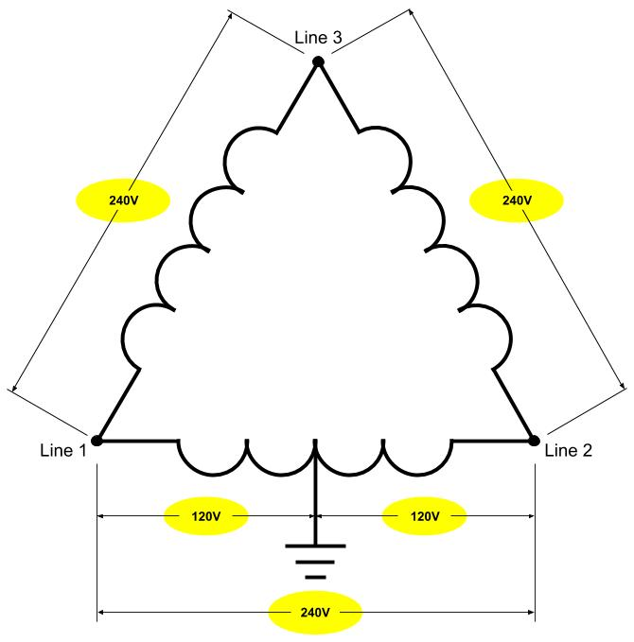
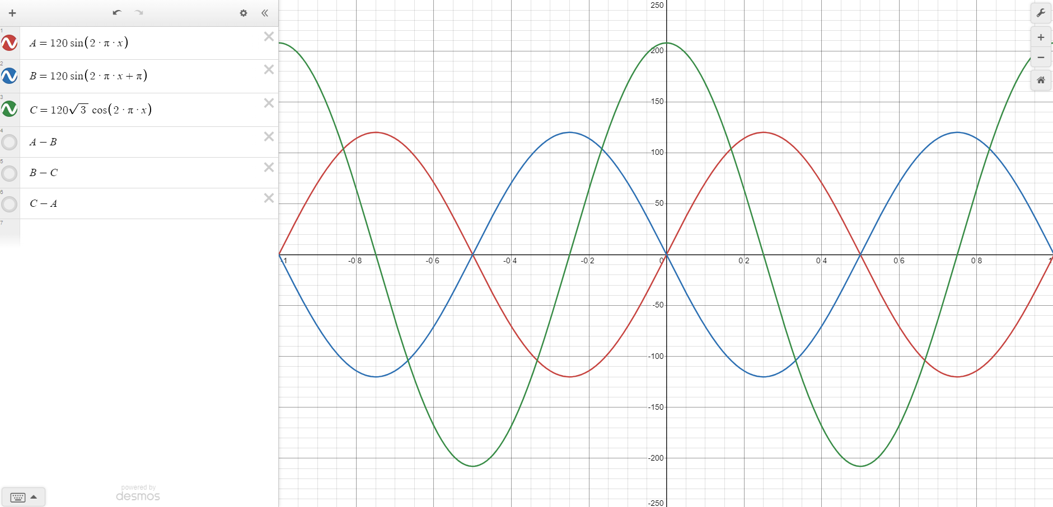
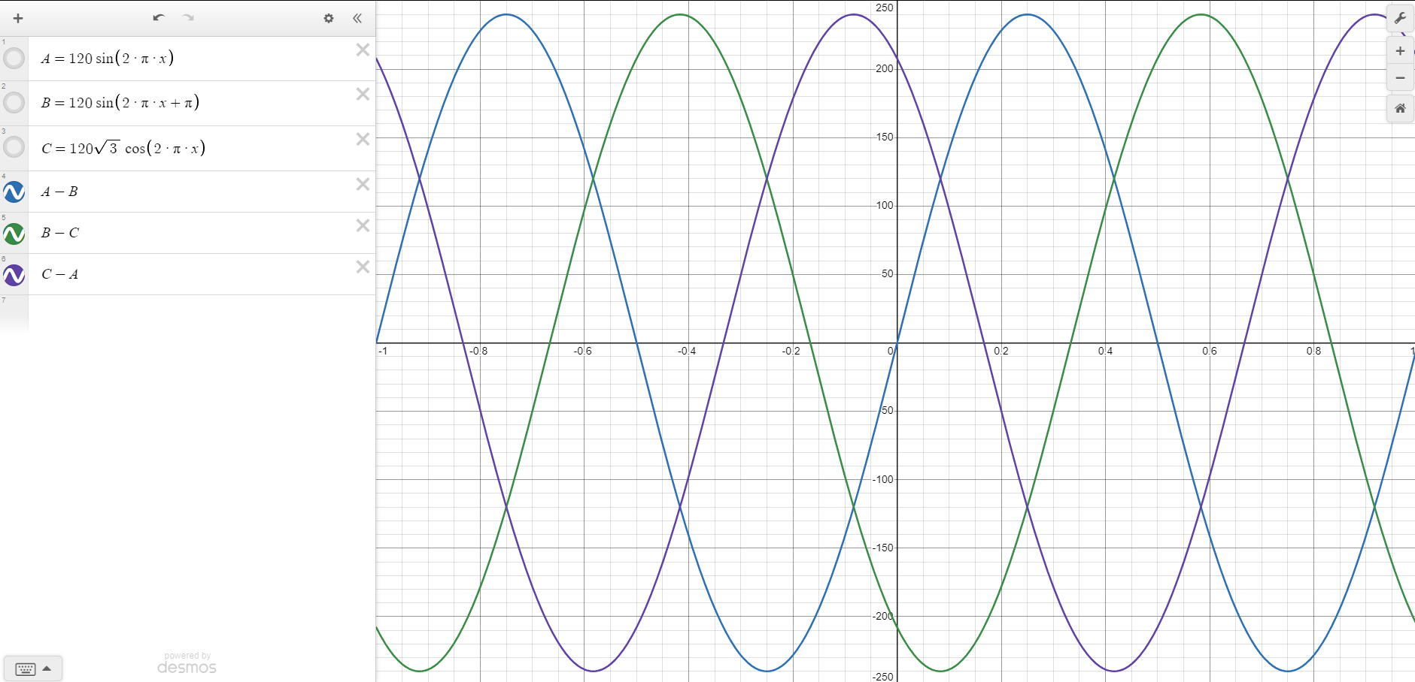
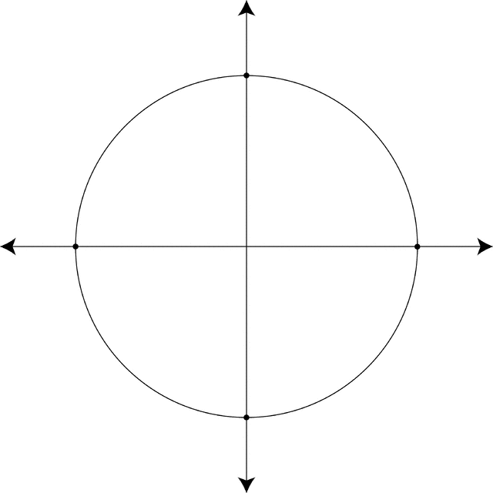
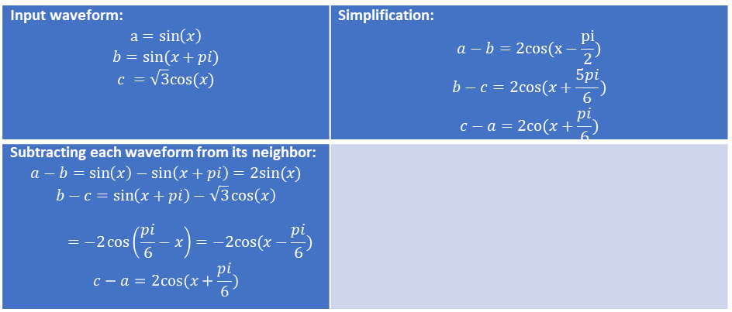
High Leg Delta Configuration
electram.com
Respect to Neutral
Pole Transformer
From Utility
Input waveform: $$a=sin\left(x\right)$$ $$b=sin(x+pi)$$ $$c =\sqrt{3}cos(x)$$ | Simplification: $$a−b=2cos(x−\frac{pi}{2})$$ $$b−c=2cos(x+\frac{5pi}{6})$$ $$c−a=2co(x+\frac{pi}{6})$$
Subtracting each waveform from its neighbor: $$a−b=\sin\left(x\right)−\sin\left(x+pi\right)=2sin⁡(x)$$ $$b−c=\sin\left(x+pi\right)−\sqrt{3}\cos\left(x\right)$$ $$=−2\cos\left(\frac{pi}{6}−x\right)=−2cos(x−\frac{pi}{6})$$ $$c−a=2cos(x+\frac{pi}{6})$$
Respect to Each Other

Slide 6
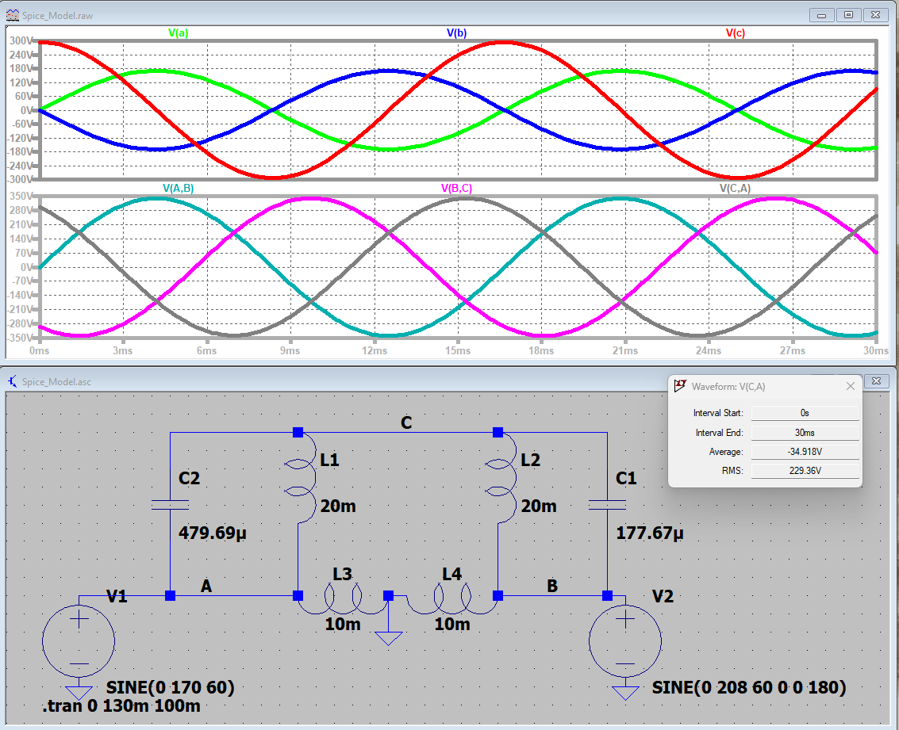
Crude Circuit Mathematical Approximation
$$V_{0}=\frac{V_{1}\left(s^{2}LC_{1}+sRC_{1}+1\right)+V_{2}(s^{2}LC_{2}+sRC_{2}+1)}{s^{2}L\left(C_{1}+C_{2}\right)+sR\left(C_{1}+C_{2}\right)+2}$$
Code:
%Constants
V1 = 120*sqrt(2);
V2 = -120*sqrt(2);
w = 2 * pi * 60;
s = w * 1j;
R = 2;
L = 20E-3;
desired_H = 120*sqrt(3)*sqrt(2) * exp(1j * 90 * pi/180);
%Transfer Function
numerator = V1*((s*C1) + (1/((s*L)+R))) + V2*((s*C2) + (1/((s*L)+R)));
denominator = (s*C1) + (2/((s*L)+R)) + (s*C2);
H = numerator/denominator;
%Fitting
eq1 = real(H) == real(desired_H);
eq2 = imag(H) == imag(desired_H);
sol = vpasolve([eq1, eq2], [C1, C2], [0.0001, 0.0001]);
%Print
fprintf('C1 = %.2f µF\n', double(sol.C1) * 1e6);
fprintf('C2 = %.2f µF\n', double(sol.C2) * 1e6);
Output:
C1 = 479.69 µF
C2 = 177.67 µF
Ignores loading from tool motor
Incorrect model of an induction motor (ignores the fact that it is rotating)
Assumes all windings are exactly the same

Slide 7
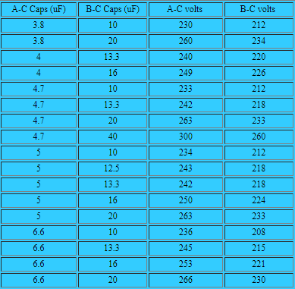
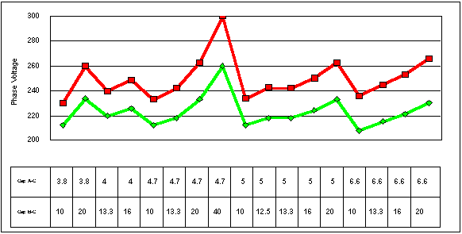
How It is Actually Found
Everyone does guess and check with a multimeter
Rule of thumb of 5uF per HP on phase A-C
Double it for phase B-C
Too many non-idealities to bother with calculations
Waterfront Woods
Waterfront Woods

Slide 8
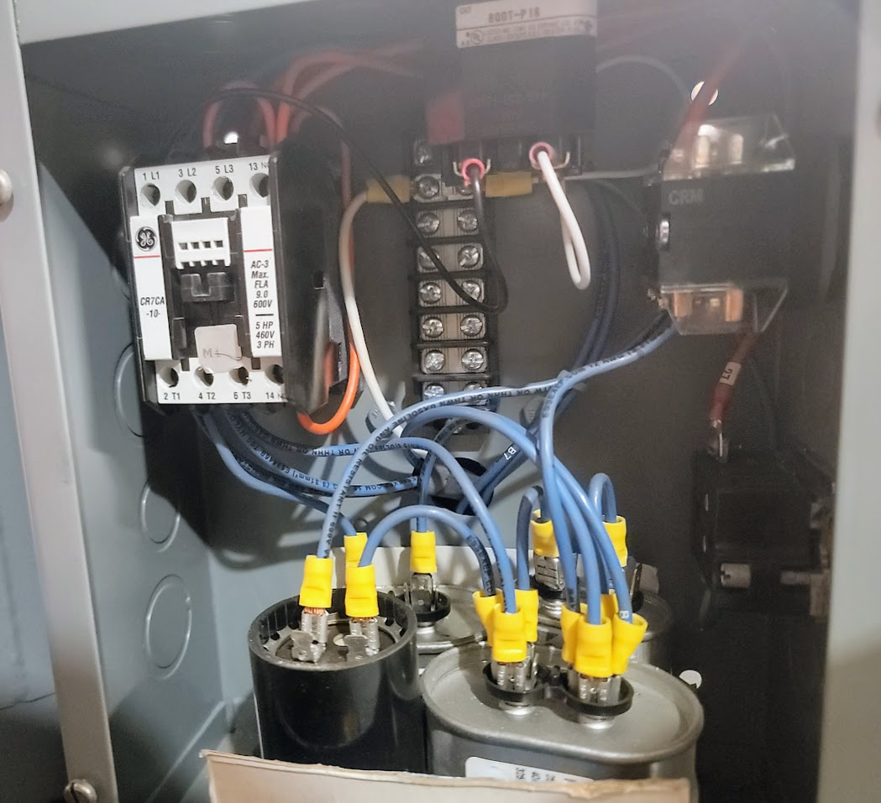
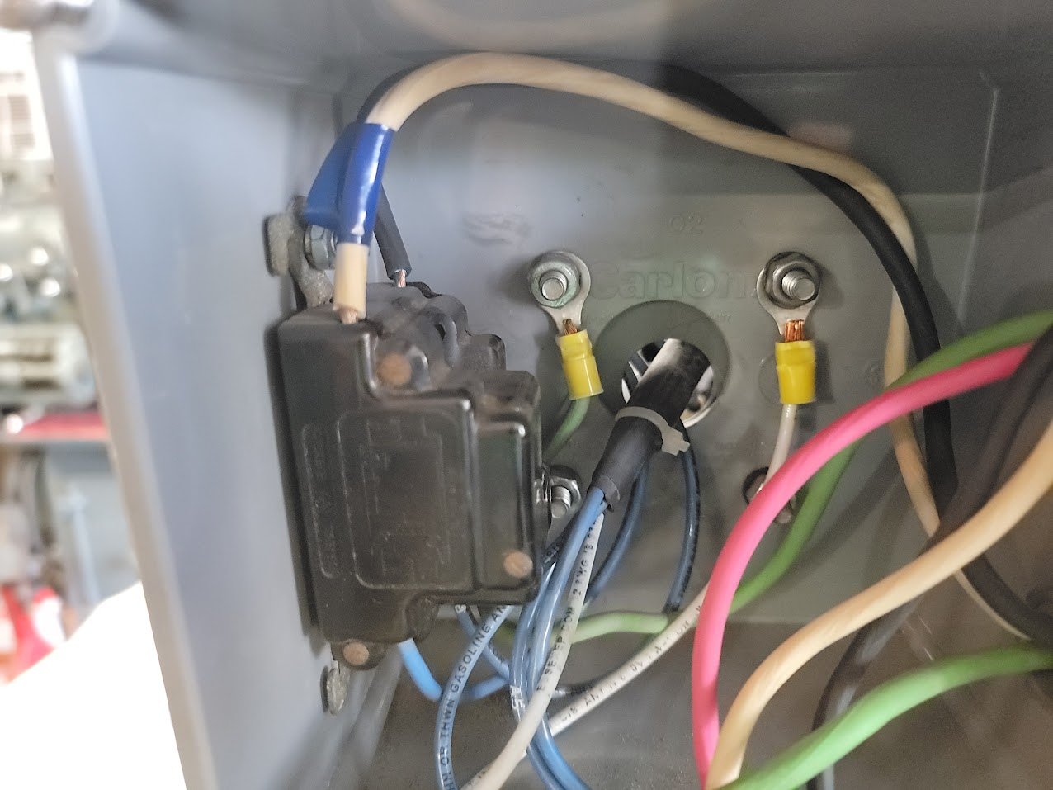
Goals for this Project
Upgrade phase converter that was built in the early 2000’s
Add Auto Start Stop
Have single phase power on for lighting even when the converter is off
One button push start
Add a current meter
Tune in the voltage and phase using oscilloscope measurements

Slide 9
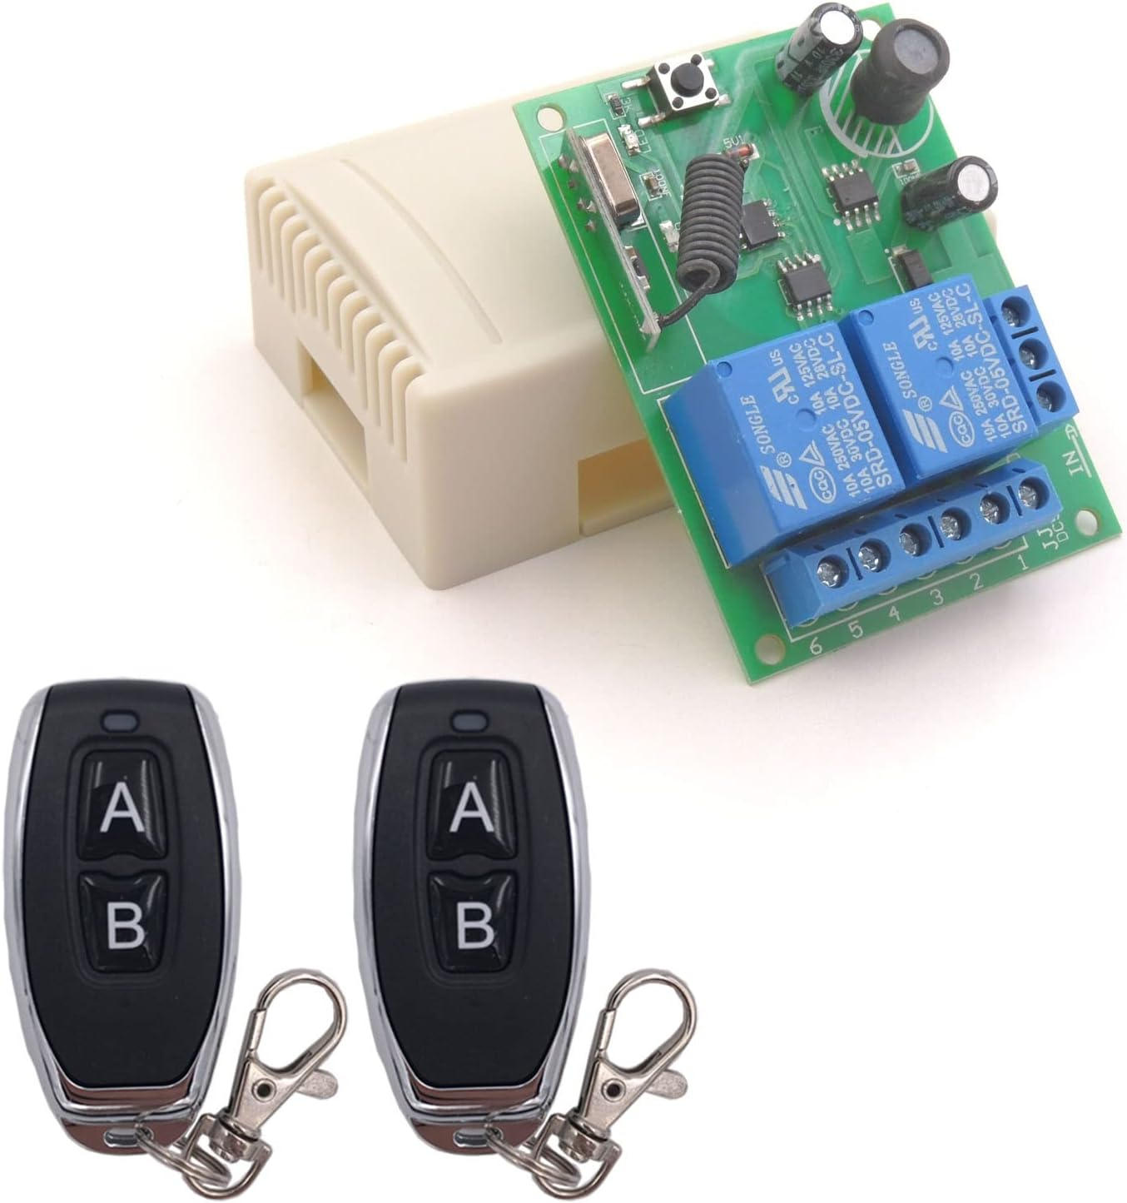
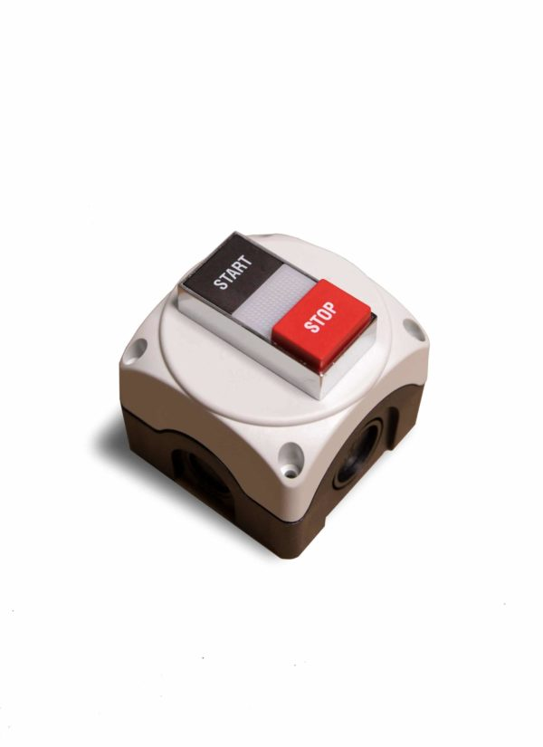
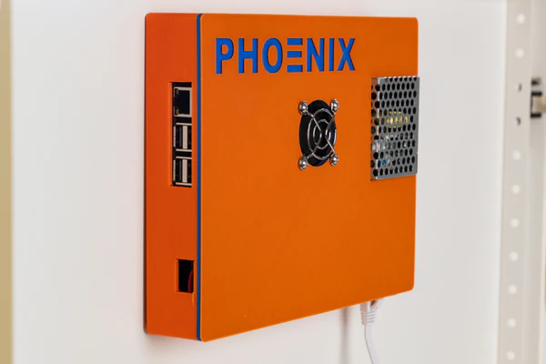
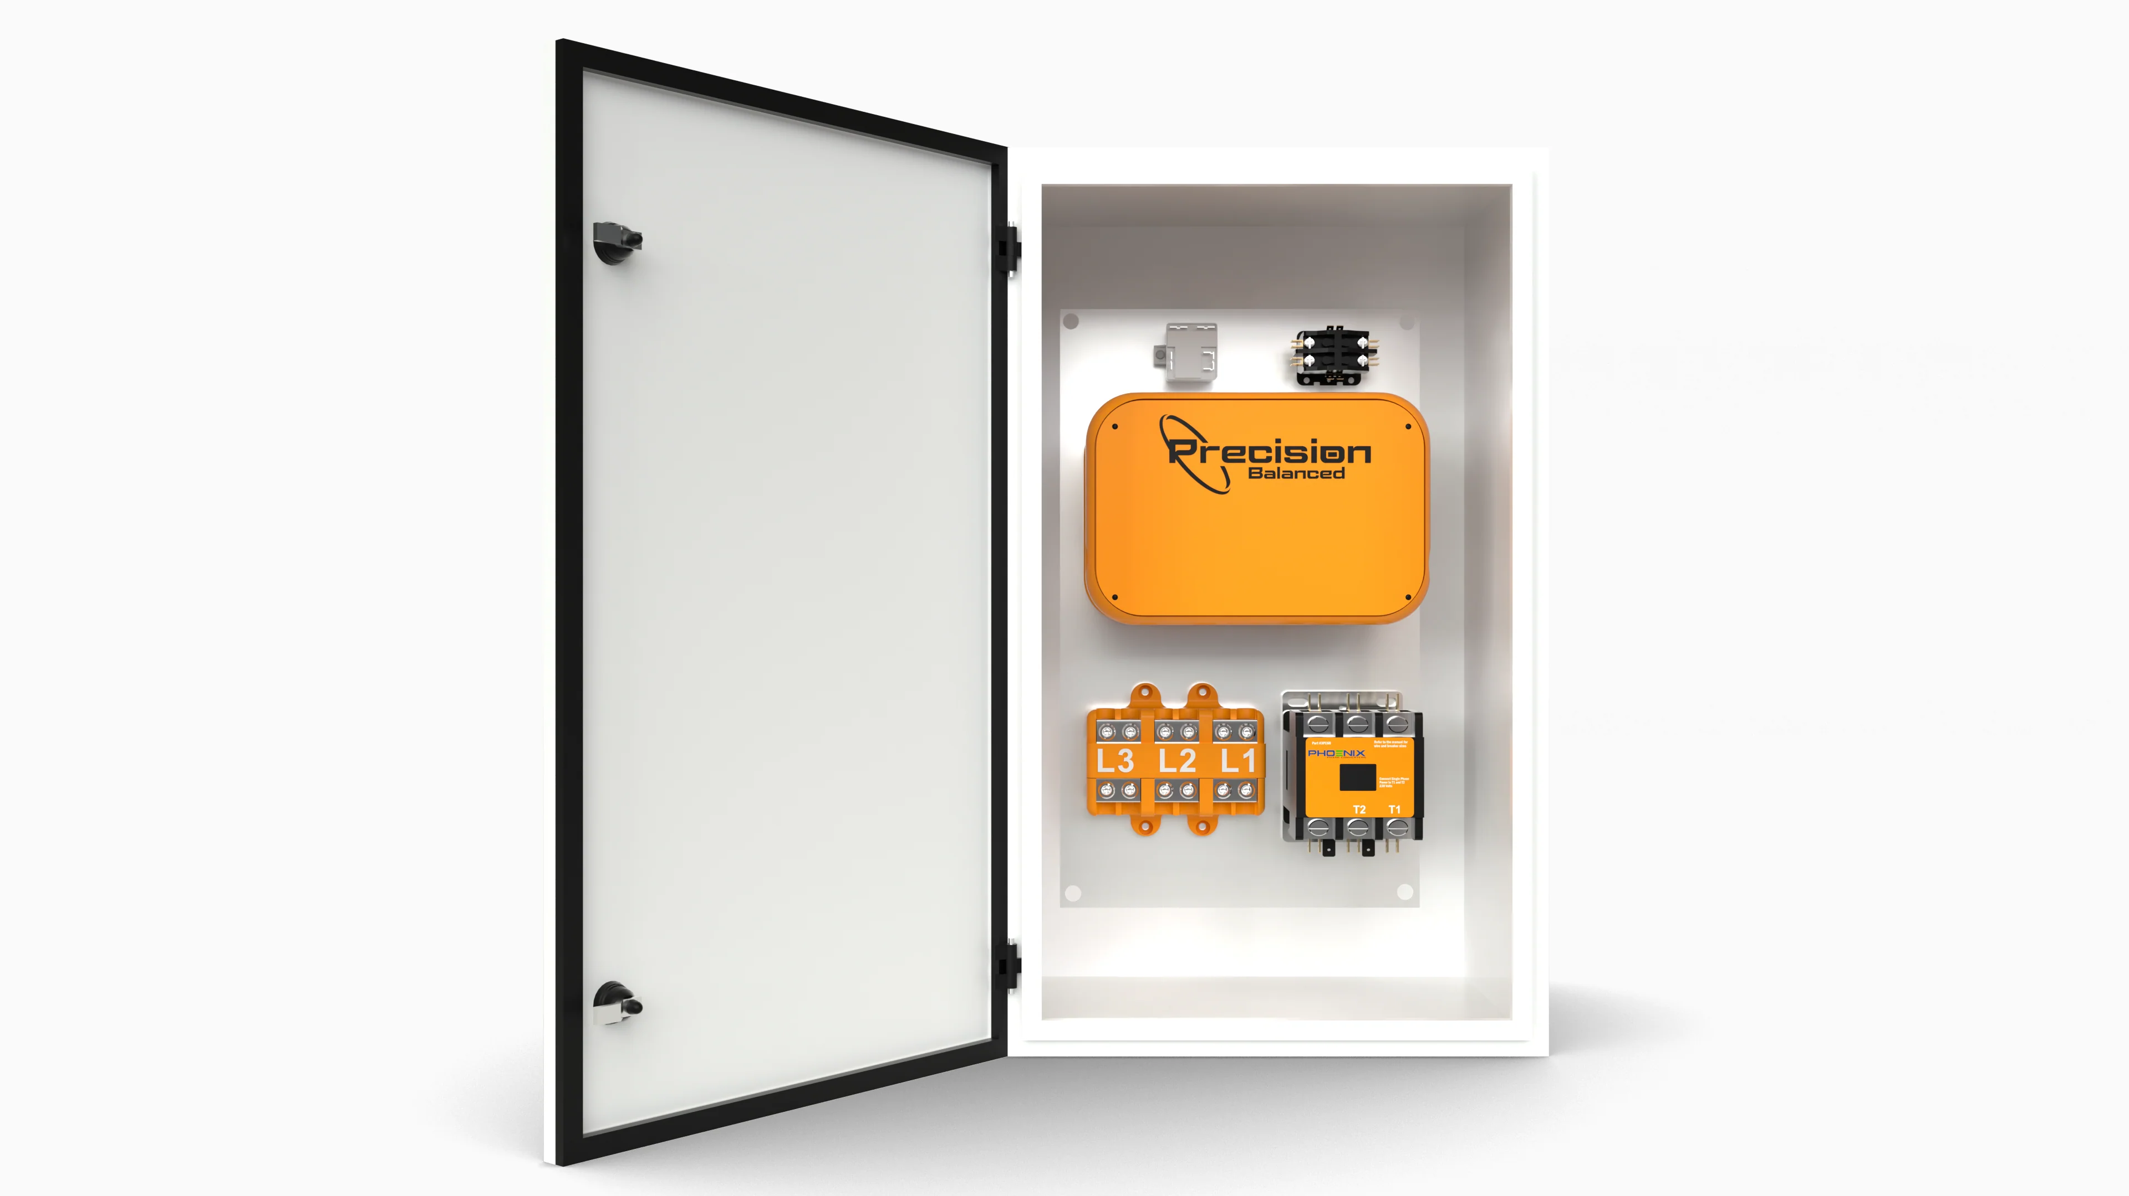
Current Solutions
Use a RF remote control connected to a relay in the converter
Place an additional wired switch next to each machine for the converter
Use a much larger start capacitor, and turn on both motors at the same time using a sense wire
Phoenix Phase Converters holds patent on similar solution to mine
Optional add on (doubles price of the standard model)
Company has poor reviews, questionable quality, loud undersized and too fast of motors, and is overpriced
Amazon.com
American Rotary
www.phoenixphaseconverters.com

Slide 10
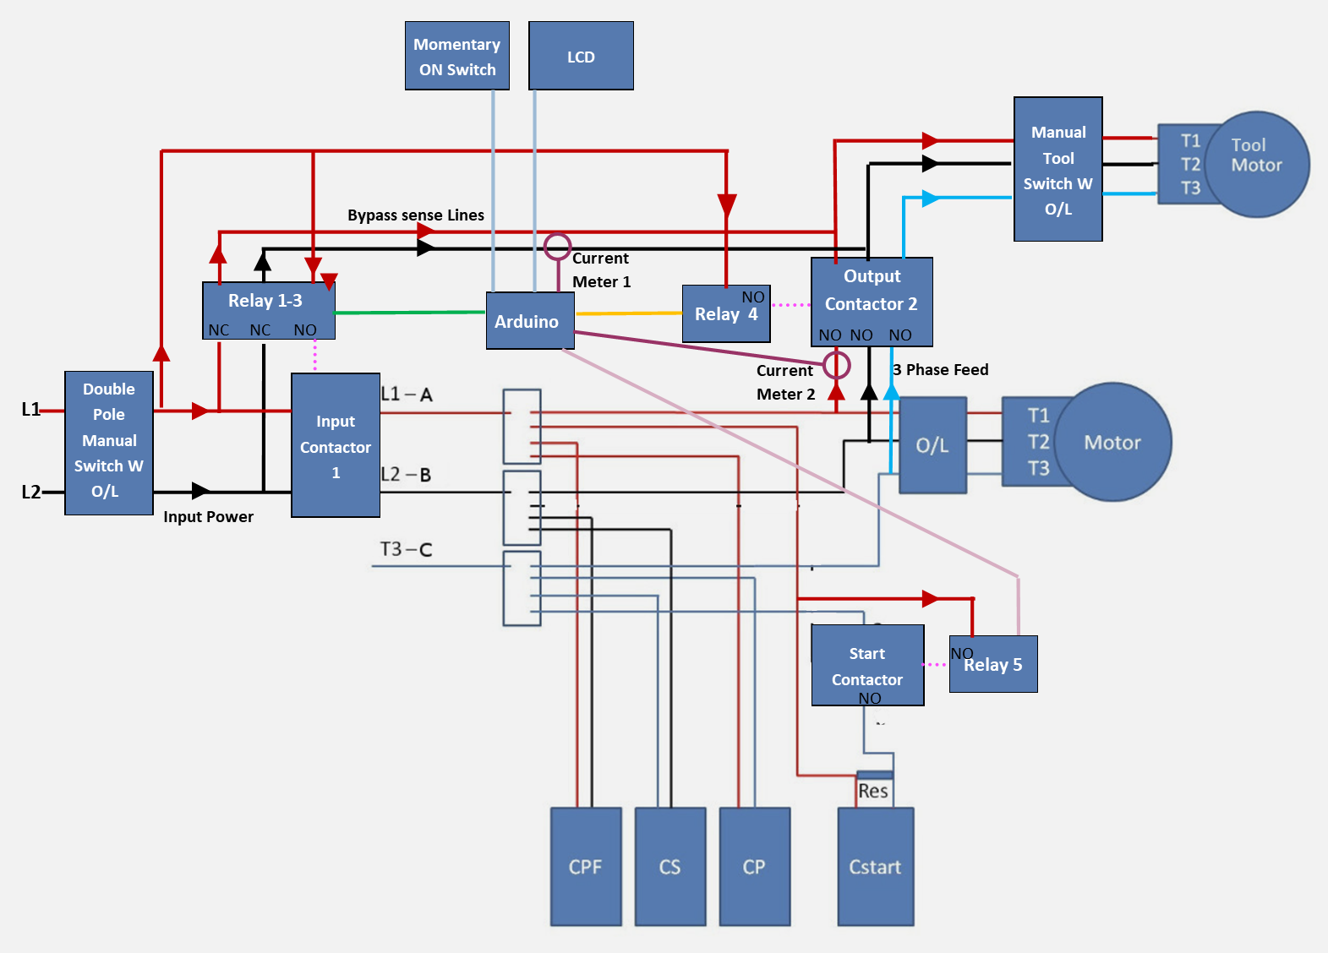
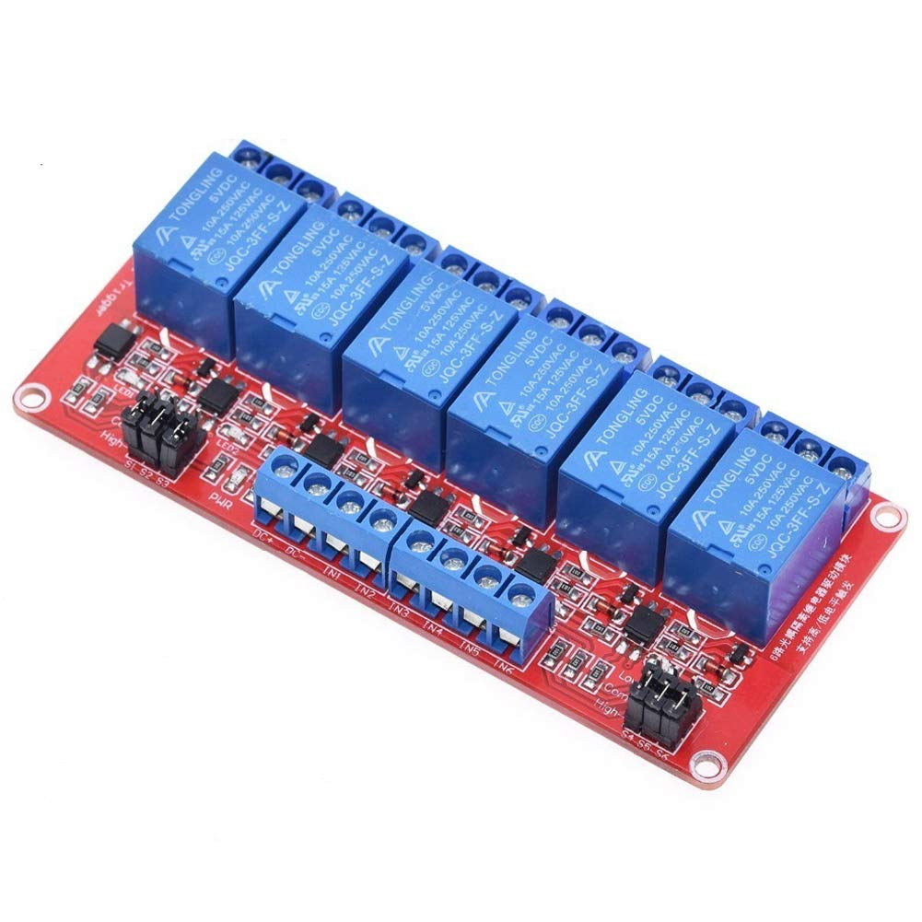
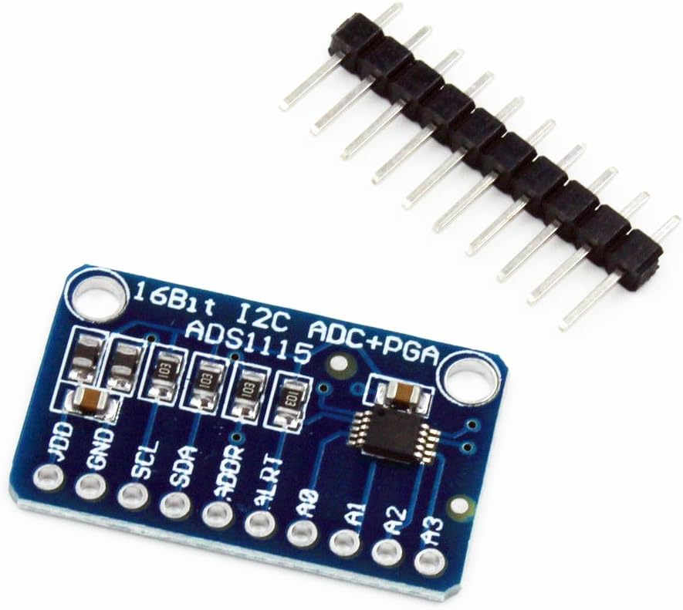
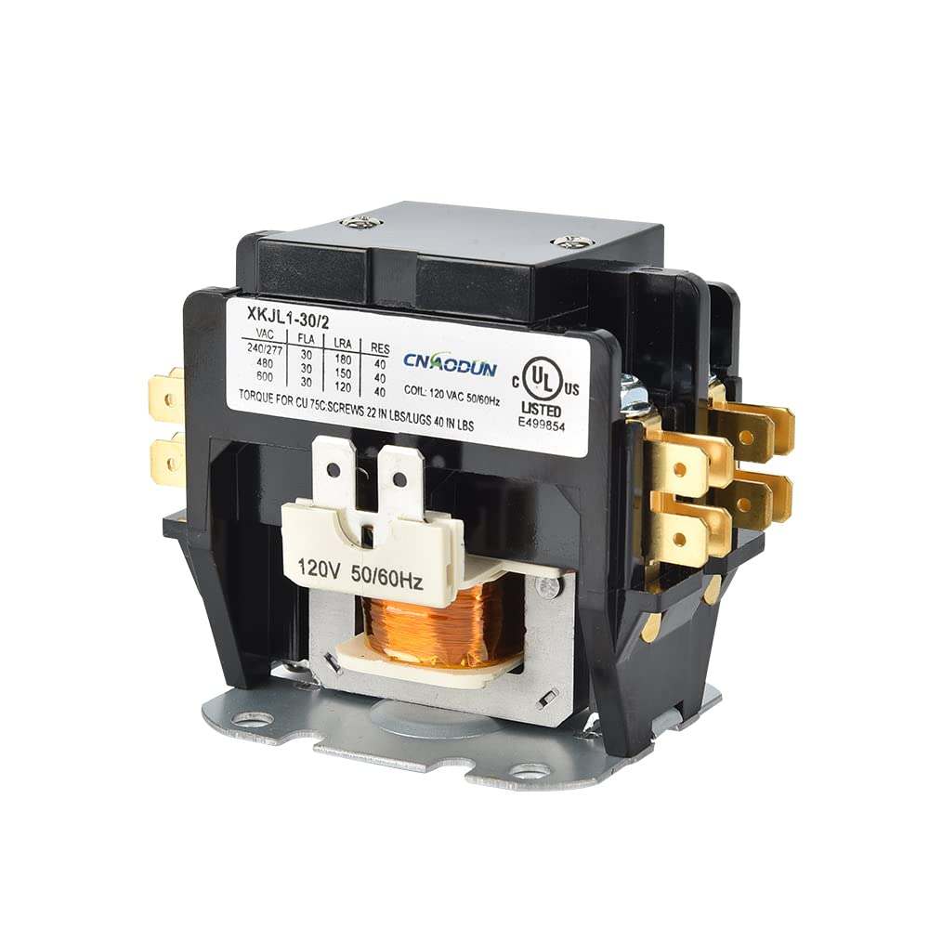
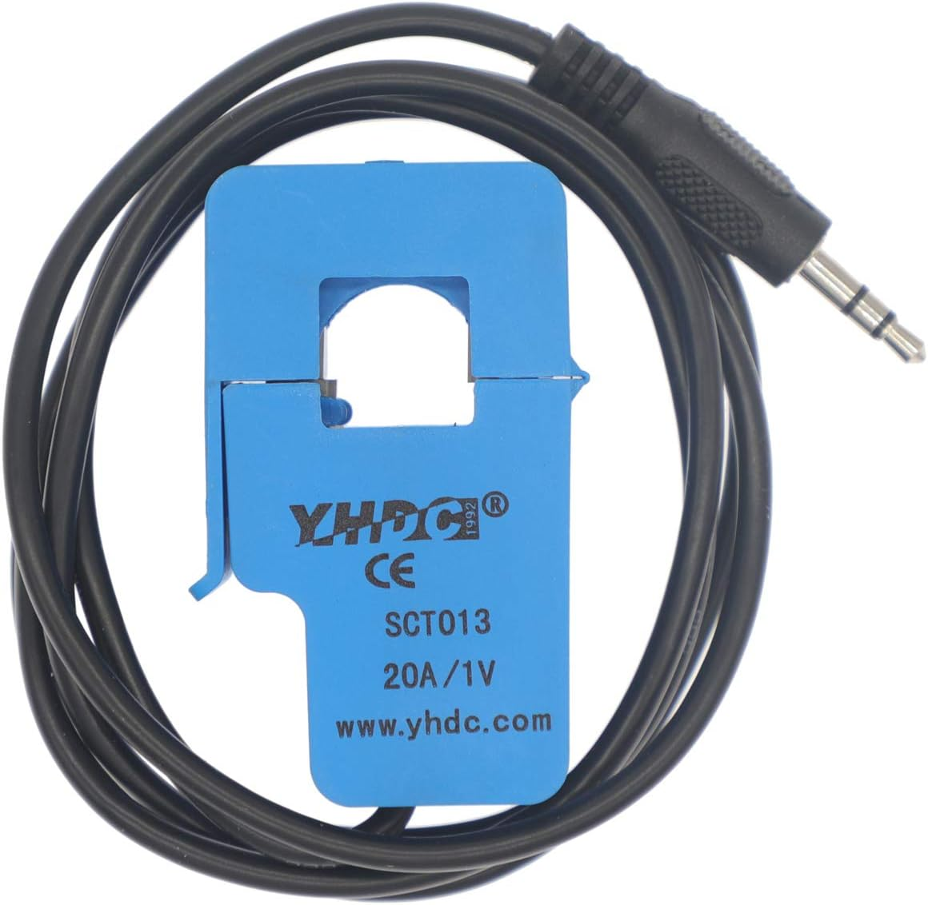
Start:
When current meter 1 reads high current, or on switch is pushed flip relays in order:
5 ->50ms- 1,2,3 ->250ms- 5 -> 500ms- 4
Stop:
1,2,3,4
Idler
6 Relay Board
Single Pole Contactor
Double Pole Contactor
Tripple Pole Contactor
Arduino Nano
ADS1115 I2C dual channel differential ADC
2 - SCT013 20A 1V Current Transformer

Slide 11
Software
Arduino Nano (Don’t need anything fancy and had a couple lying around)
Setup | Main Loop | Start, Stop, RMS Functions
#include <Wire.h> #include <Adafruit_ADS1X15.h> #include <LiquidCrystal_I2C.h> Adafruit_ADS1115 ads; LiquidCrystal_I2C lcd(0x27, 16, 2); // Pins and Constants const float FACTOR = 20; // 20A/1Vfrom the CT const float multiplier = 0.00005; const int startPin = 6; const int l1Pin = 5; const int l2Pin = 4; const int contactor1Pin = 3; const int contactor2Pin = 2; const int emergencyStart = 7; const int digital_ground = 8; void setup() { // I2C Voltmeter setup Serial.begin(9600); ads.setGain(GAIN_FOUR); //+/-1.024V,1 bit =0.5mV ads.begin(); // Set up the digital pins as outputs pinMode(startPin, OUTPUT); pinMode(l1Pin, OUTPUT); pinMode(l2Pin, OUTPUT); pinMode(contactor1Pin, OUTPUT); pinMode(contactor2Pin, OUTPUT); pinMode(digital_ground, OUTPUT); // Initialize the output states digitalWrite(startPin, LOW); digitalWrite(l1Pin, LOW); digitalWrite(l2Pin, LOW); digitalWrite(contactor1Pin, LOW); digitalWrite(contactor2Pin, LOW); digitalWrite(digital_ground, LOW); pinMode(emergencyStart, INPUT_PULLUP); // Initialize the LCD display lcd.init(); lcd.backlight(); lcd.setCursor(0, 0); lcd.print("Current (A): "); } | void loop() { // Stays in this while loop until current is higher than .5A while((ads.readADC_Differential_0_1()*multiplier*FACTOR) < .5) { //When start button is pushed, start motor and run forever if (digitalRead(emergencyStart) == LOW) { startMotor(); //Stop Converter by flipping manual power switch while (true) { lcd.setCursor(0, 1); lcd.print(getcurrent_RUN()); delay(500); } } lcd.setCursor(0, 1); lcd.print(0.00); } // Start motor now that the current is high startMotor(); float Current = getcurrent_RUN(); // Stay running while the rms current is greater than 1A while (Current > 1) { Current = getcurrent_RUN(); lcd.setCursor(0, 1); lcd.print(Current); } // Stop motor then delay for 3s to allow idler to spin down stopMotor(); delay(3000); } | void startMotor() { digitalWrite(startPin, HIGH); delay(50); digitalWrite(l1Pin, HIGH); digitalWrite(l2Pin, HIGH); digitalWrite(contactor1Pin, HIGH); delay(250); digitalWrite(startPin, LOW); delay(500); digitalWrite(contactor2Pin, HIGH); } void stopMotor() { digitalWrite(l1Pin, LOW); digitalWrite(l2Pin, LOW); digitalWrite(contactor1Pin, LOW); digitalWrite(contactor2Pin, LOW); } // Calculate RMS Running Current float getcurrent_RUN() { float voltage; float current; float sum = 0; long time_check = millis(); int counter = 0; // Measure current for 1 second while (millis() - time_check < 1000) { voltage = ads.readADC_Differential_2_3() * multiplier; current = voltage * FACTOR; sum += sq(current); counter++; } // Calculate RMS current current = sqrt(sum / counter); return current; }

Slide 12
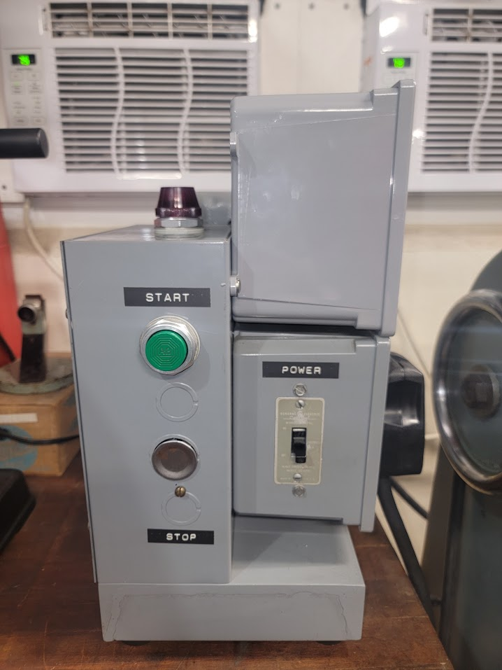
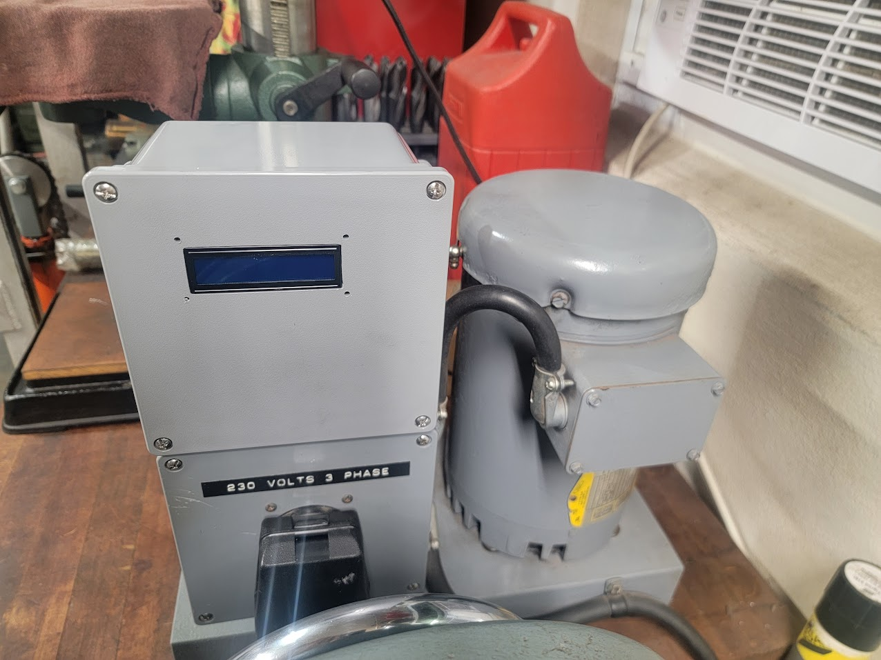
External Photos
Control Electronics
Arduino
Relay Board
ADC
AC/DC Converter
Main Compartment
Capacitors
Start Contactor
Main power Contactor
Indicator light
Start Switch
Output Side
2 Pole Toggle Switch with O/L heater
Dryer Plug
3 Pole Output Contactor
Idler Motor

Slide 13
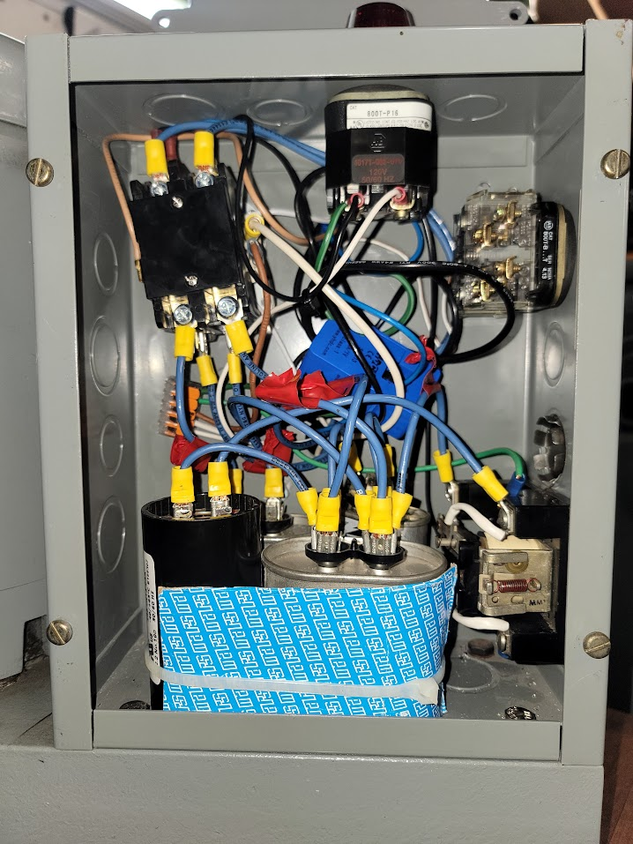
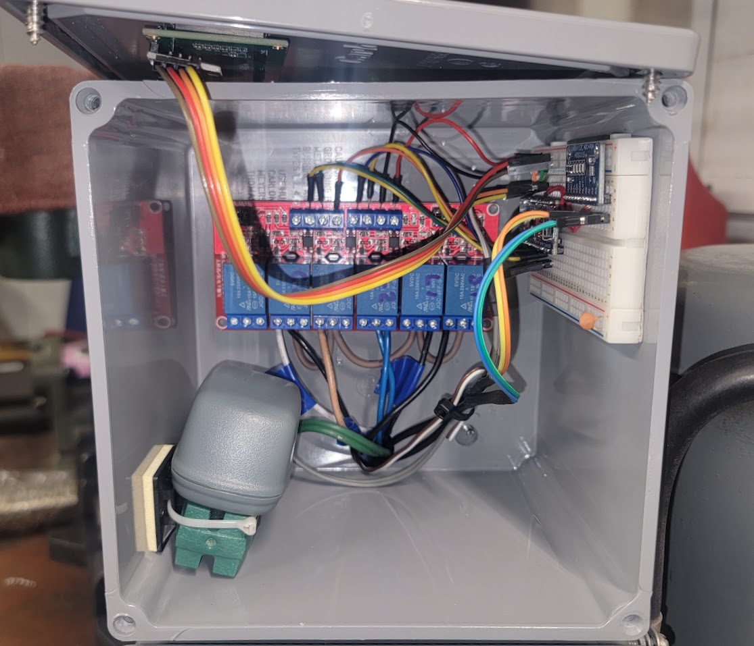
Internal Photos
Indicator Light
Input Contactor
LCD
Arduino Nano
Start Button
Relay Board
Start Contactor
5V Power Supply
ADS 1115
Capacitor Bank

Slide 14
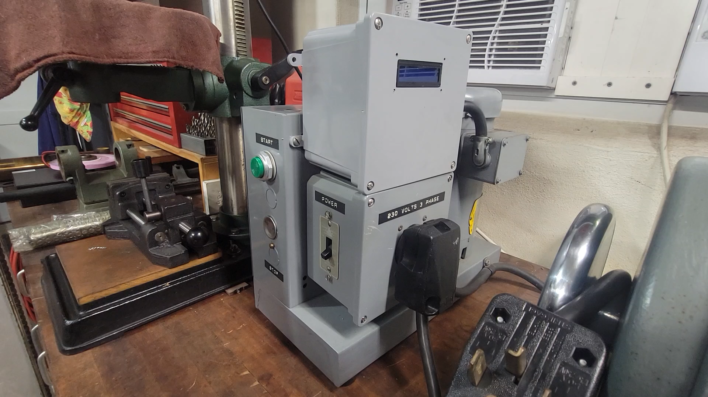

Slide 15
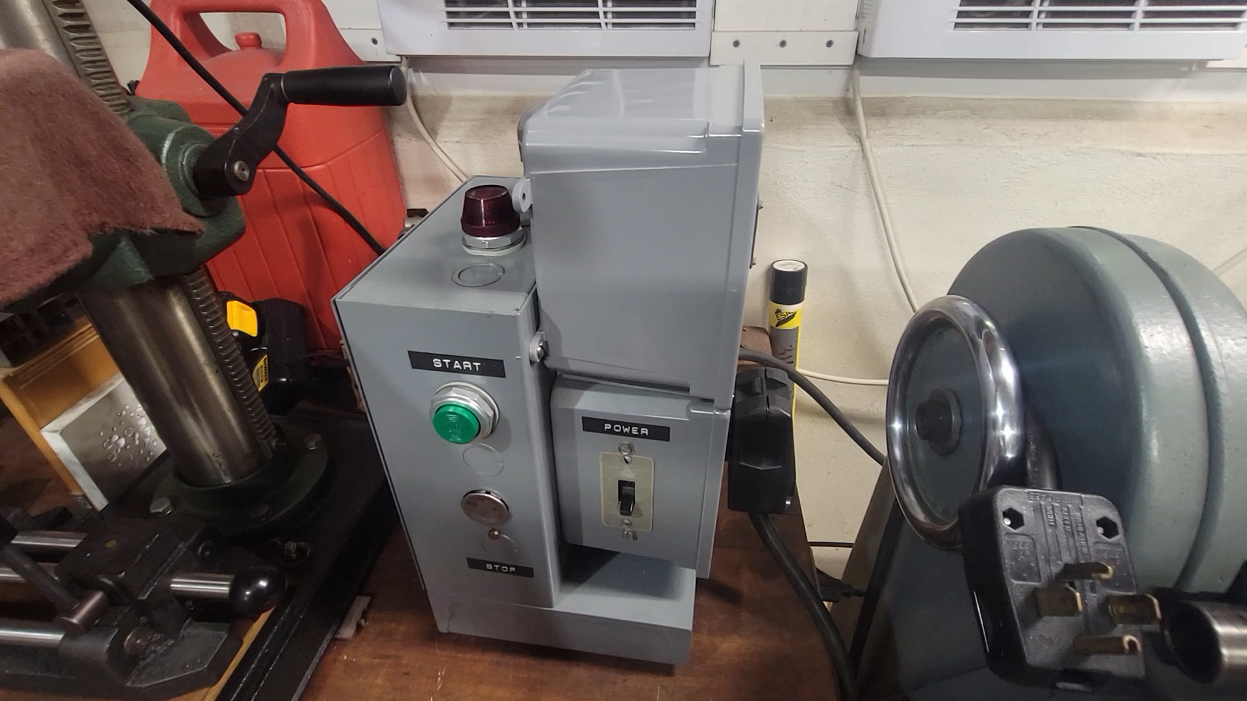

Slide 16
Evaluating Performance
Do not own differential 400V 100x probes for obvious reasons
Wrote Matlab Script to measure using standard 10x probes
Connect to Oscilloscope over WIFI or USB with NIVISA
Obtain Data
Fit as sinusoids to find phase and amplitude
Plot (loop with some optimizations to get auto updating plot every second)
No Load

Slide 17
Connect to Siglent SDS1104x-e | Pull, Process, and Fit Data | Plot Data
%% Variables % Define constants and parameters INPUT_BUFFER_SIZE = 2^9; % Input buffer size in bytes (512 bytes) TIMEOUT = 5; % Timeout for communication in seconds DATA_HEADER_LENGTH = 16; % Length of data header in bytes DATA_END_LENGTH = 2; % Length of data end in bytes connStr = 'USB0::0xF4EC::0xEE38::SDSMMFCQ5R7215::INSTR’; warning('off', 'instrument:visa:ClassToBeRemoved') %% Determine Settings % Set up VISA object for instrument communication visaObj = visa('ni', connStr); visaObj.InputBufferSize = INPUT_BUFFER_SIZE; visaObj.Timeout = TIMEOUT; fopen(visaObj); fwrite(visaObj, 'CHDR OFF'); % Turn off headers to receive raw data flushoutput(visaObj); % Query instrument settings vDiv = str2double(query(visaObj, 'C1:VDIV?')); % Voltage division sCount = str2double(query(visaObj, 'SANU? C1')); % Sample count tDiv = str2double(query(visaObj, 'TDIV?')); % Time division sRate = str2double(query(visaObj, 'SARA?')); % Sample rate flushinput(visaObj); fclose(visaObj); delete(visaObj); clear visaObj; %% Connect % Re-create VISA object with adjusted input buffer size visaObj = visa('ni', connStr); visaObj.InputBufferSize = sCount + DATA_HEADER_LENGTH + DATA_END_LENGTH; visaObj.Timeout = TIMEOUT; fopen(visaObj); fwrite(visaObj, 'CHDR OFF'); % Turn off headers to receive raw data flushoutput(visaObj); | %% Pull Data % Query waveform data for each channel fwrite(visaObj, 'C1:WF? DAT2'); flushoutput(visaObj); r1 = fread(visaObj); flushinput(visaObj); *Repeat for C2 and C3* %% Decode Time % Extract time data from the received raw data d1 = r1((DATA_HEADER_LENGTH + 1):(end - DATA_END_LENGTH)); *Repeat for C2 and C3* outputSize = size(d1); % Calculate time vector based on time division and sample rate timeOut = zeros(outputSize); for i = 1:1:outputSize timeOut(i) = -(tDiv * 14 / 2) + ((i - 1) * (1 / sRate)); end %% Decode raw data % Convert raw data to voltage for each channel C1 = zeros(outputSize); *Repeat for C2 and C3* for i = 1:1:outputSize % Adjust signedness of raw data if d1(i) > 127 d1(i) = d1(i) - 255; end if d2(i) > 127 d2(i) = d2(i) - 255; end if d3(i) > 127 d3(i) = d3(i) - 255; end % Convert to voltage using voltage division C1(i) = d1(i) * (vDiv / 25); C2(i) = d2(i) * (vDiv / 25); C3(i) = d3(i) * (vDiv / 25); end % Calculate voltage differences Diff1 = C1 - C2; Diff2 = C2 - C3; Diff3 = C3 - C1; | %% Finding Phase [xData, yData] = prepareCurveData( timeOut, Diff1 ); ft = fittype( 'a*sin(120*pi*x+b)', 'independent', 'x', 'dependent', 'y' ); opts = fitoptions( 'Method', 'NonlinearLeastSquares' ); opts.Display = 'Off'; opts.Lower = [200 -3.2]; opts.StartPoint = [300 0]; opts.Upper = [400 3.2]; [fitresult, ~] = fit( xData, yData, ft, opts ); D1 = fitresult.b; %% Plotting p1 = -rad2deg(c1-c3); p2 = rad2deg(c2-c1); p3 = rad2deg(c3-c2) + 360; phaseDiff1_2_deg = rad2deg(D2-D1); phaseDiff2_3_deg = rad2deg(D3-D2)+360; phaseDiff3_1_deg = rad2deg(D1-D3); % Original plots figure('Position', [350, 150, 800, 700]); subplot(211) hold on; plot(timeOut, C1, 'LineWidth', 2, 'Color', 'b') plot(timeOut, C2, 'LineWidth', 2, 'Color', 'g') plot(timeOut, C3, 'LineWidth', 2, 'Color', 'r') xlabel('Time') ylabel('Voltage') title('Voltage with Respect to Neutral') legend('C1', 'C2', 'C3') grid on; hold off; maxVoltage_C1 = max(C1); maxVoltage_C2 = max(C2); maxVoltage_C3 = max(C3); *Add Text to the plots over on the right* *Repeat for the subtracted data*

Slide 18
Evaluating Performance
Under a standard load (1 machine) voltage and phase errors are both under 2%
Shaper – 1.7A
Shaper and Bridgeport together - 3.74A
Voltage Sags Under Load!

Slide 19
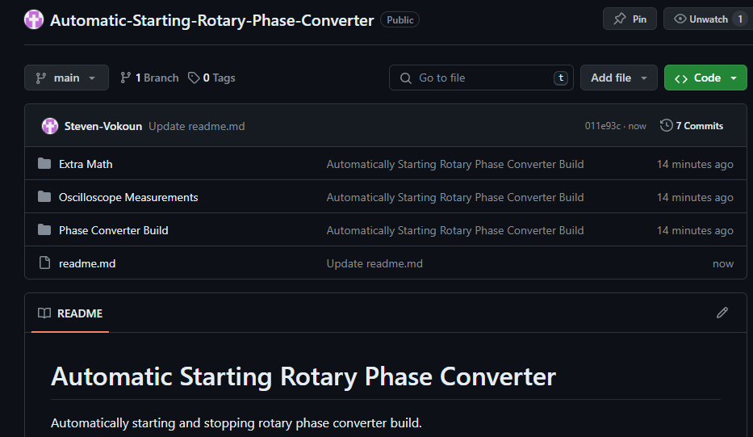
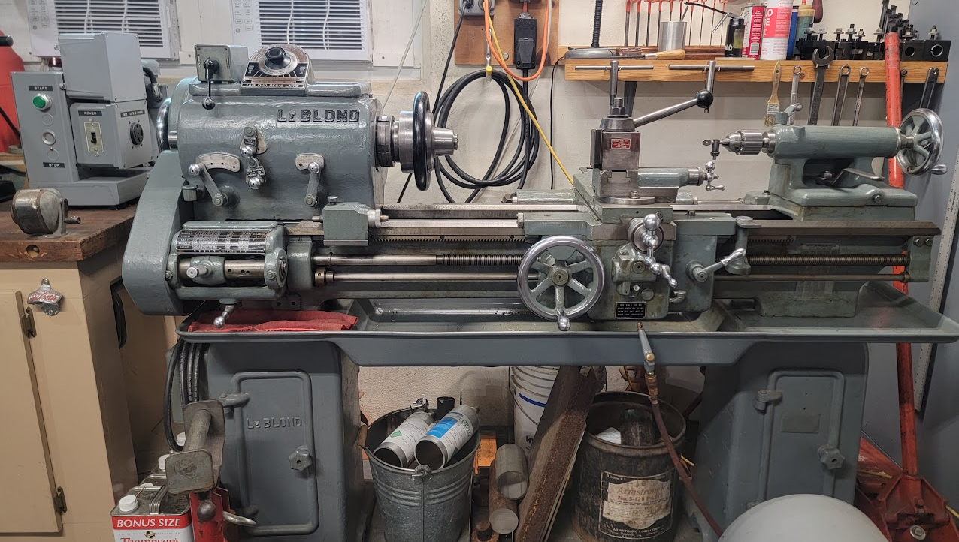
Conclusion
Been working for a month or so now with no issues
Oversized all components to eventually replace the 2HP idler with a 7HP one
Put it all into a GitHub

